Slide 1
Numerical Methods
For solving Partial Differential equation

Slide 2
Classification of PDE:
Physical Classification:
Equilibrium Problems
Marching Problems
Mathematical Classification:
Parabolic
Hyperbolic
Elliptic

Slide 3

Mathematical Classification:
General Second Order PDE:
$$a\frac{∂^{2}u}{∂x^{2}}+b\frac{∂^{2}u}{∂x∂y}+c\frac{∂^{2}u}{∂y^{2}}+ⅆ\frac{∂u}{∂x}+ⅇ\frac{∂u}{∂y}+fu=g\left(x,y\right)$$
Parabolic PDE: $b^{2}−4ac=0$
Hyperbolic: $b^{2}−4ac>0$
Elliptic: $b^{2}−4ac<0$

Slide 4


Equilibrium Problems
Equilibrium problems are problems in which a solution of a given PDE is desired in a closed domain subject to a prescribed set of boundary conditions. Equilibrium problems are boundary value problems.
PDEs must be satisfied in D. Boundary conditions must be satisfied on B. Mathematically, equilibrium problems are governed by elliptic PDEs.

Slide 5



Marching problems
Marching problems are transient problems where the solution of a PDE is required on an open domain subject to a set of initial conditions and a set of boundary conditions.
Generally marching problems are initial value or initial boundary value problems. Mathematically, these problems are governed by either hyperbolic or parabolic PDEs.
The solution must be computed by marching outward from initial data surface while satisfying boundary conditions.
Initial surface

Slide 6
Solution of PDE
Analytic Solution
Approximate Solution/ Numerical Solution

Slide 7
Numerical solution
Advantages:
Can be applied on complex geometry
Some of the PDE nearly impossible to solve analytically. Numerical methods must be used on those problem
Easy to apply
Disadvantages:
It gives approximate result
Sometime needs lots of time
Solving process can be computationally costly

Slide 8
Types of numerical methods
Finite Difference Method (FDM)
Finite Element Method (FEM)
Finite Volume Method (FVM)

Slide 9
Some definition
Discretization: In applied mathematics, discretization is the process of transferring continuous functions, models, variables, and equations into discrete counterparts.
Truncation Error: A truncation error is the difference between an actual and a truncated or cut-off value.
Round off Error: A round-off error, is a mathematical miscalculation or quantization error caused by altering a number to an integer or one with fewer decimals.
Discretization Error: An error caused by replacing the continuous problem by a discrete problem. It is defined as the difference between exact solution of PDE and exact solution of FDE when both are round off error free.

Slide 10
FDM: Definition
In FDM, the continuous problem is discretized so that the dependent variables are considered to exist only at a discrete points.

Slide 11

FDM: an intuition
Definition of Derivative:
$$\frac{ⅆf}{ⅆx}=\lim_{Δx→0}\frac{f\left(x+Δx\right)−f\left(x\right)}{Δx}$$
For small ∆x we can write,
$\frac{ⅆf}{ⅆx}≈\frac{f\left(x+Δx\right)−f\left(x\right)}{Δx}$

Slide 12






FDM: An intuition
Forward Difference:
$\frac{ⅆy}{ⅆx}=\frac{y_{i+1}− y_{i}}{Δx}$
Backward Difference:
$\frac{ⅆy}{dx}=\frac{y_{i }−{ y}_{i−1}}{Δx}$
Central Difference:
$\frac{ⅆy}{ⅆx}=\frac{y_{i+1}− y_{i−1}}{2\left(Δx\right)}$

Slide 13

FDM FOR PDE
Definition of derivative of a function u(x , y) at x = x₀ and y = y₀
$${\left(\frac{∂u}{∂x}\right)}_{0}=\lim_{Δx→0}\frac{u\left(x_{0}+Δx,y_{0}\right)−u\left(x_{0},y_{0}\right)}{Δx}$$

Slide 14

TAYLOR Series
$$f\left(x+a\right)=f\left(x\right)+\frac{a}{1!}\frac{∂f}{∂x}+\frac{a^{2}}{2!}\frac{∂^{2}f}{∂x^{2}}+\frac{a^{3}}{3!}\frac{∂^{3}f}{∂x^{3}}+…$$

Slide 15

Developing a Taylor series expansion for U(x₀ + ∆x, y₀) about the point U(x₀ , y₀)
$$u\left(x_{0}+Δx,y_{0}\right)=u\left(x_{0},y_{0}\right)+\frac{Δx}{1!}{\left(\frac{∂u}{∂x}\right)}_{0}+\frac{{\left(Δx\right)}^{2}}{2!}{\left(\frac{∂^{2}u}{∂x^{2}}\right)}_{0}+…$$
Or, ${\left(\frac{∂u}{∂x}\right)}_{0}=\frac{u\left(x_{0}+Δx,y_{0}\right)−u\left(x_{0},y_{0}\right)}{Δx}−\frac{Δx}{2!}{\left(\frac{∂^{2}u}{∂x^{2}}\right)}_{0}−…$

Slide 16

Switching to i , j notation
$${\left(\frac{∂u}{∂x}\right)}_{i,j}=\frac{u_{i+1,j}−u_{i,j}}{Δx}+T⋅E⋅$$
T.E. is order of ∆x and can be denoted by O(x).

Slide 17

FD formula for u(x , y) of first order
Forward Difference Formula:
${\left(\frac{∂u}{∂x}\right)}_{i,j}=\frac{u_{i+1,j }− u_{i,j}}{Δx}$
Backward Difference Formula:
${\left(\frac{∂u}{∂x}\right)}_{i,j}=\frac{u_{i,j} − u_{i−1,j}}{Δx}$
Central Difference Formula:
${\left(\frac{∂u}{x}\right)}_{i,j}=\frac{u_{i+1,j} −{ u}_{i−1,j}}{2Δx}$

Slide 18

For second order approximation
$${\left(\frac{∂^{2}u}{∂x^{2}}\right)}_{i,j}=\frac{u_{i+1,j}−2u_{i,j}+u_{i−1,j}}{{\left(Δx\right)}^{2}}+O\left[{\left(Δx\right)}^{2}\right]$$
Neglecting T. E. part:
${\left(\frac{∂^{2}u}{∂x^{2}}\right)}_{i,j}=\frac{u_{i+1,j} − 2u_{i,j} + u_{i−1,j}}{{\left(Δx\right)}^{2}}$

Slide 19
Convergence, Consistency, Stability
Convergence: means the solution to the finite difference method approaches to exact solution of PDE when the mesh is refined.
Consistency: A FDM is consistence if by reduction of the mesh and time step size, the truncation error terms could be made to approach zero
Stability: A FDM is stable if the error decay as computation proceeds from one marching step to the next . Stability of a FDM can be assessed using Von Neumann stability analysis.

Slide 20
Explicit and Implicit method
Explicit method: A formula which express one unknown value at a given node in terms of the known preceding values.
FTCS method
Durfort-Frankel Method
Implicit Method: A method in which the computation of many present unknown values necessitates the solution of a set of simultaneous equations is called implicit method.
Crank-Nicolson Method

Slide 21
Steps of FDM
Discretizing the Domain
Converting the PDE into Difference equations
Choosing an appropriate method(explicit or implicit)
Solving
Post processing

Slide 22
Finite Element Method
Motivation: In finite difference method we divide the solution domain into finite numbers of discrete grid point. Then PDE is written for each grid point and derivatives is replaced by Difference formula. This method is easy to understand but has some short comings. It is difficult to apply FDM to the problems involving irregular geometry, unusual boundary conditions, or heterogenous composition.
The FEM provides an alternative that is better suited for such systems. In contrast to FDM, the FEM divides the solution domain into simply shaped regions, or “elements”

Slide 23
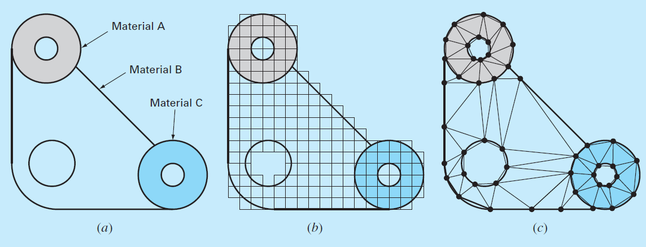
Gasket with irregular geometry and heterogeneous composition

Slide 24
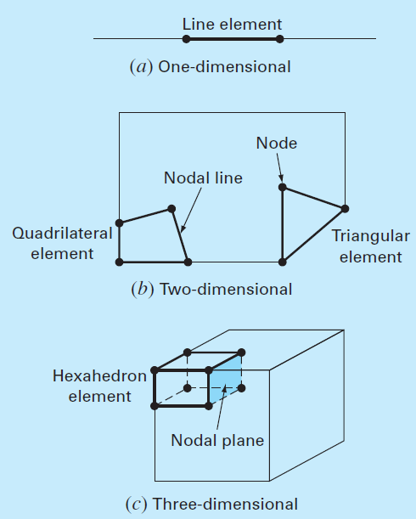
INTRODUCTION TO ELEMENT
In finite element method the region is divided into small pieces. These pieces are called elements. Elements can be one, two or three dimensional. The points of intersection of the lines that make up the sides of the elements are referred to as nodes and the sides themselves are called nodal lines or planes.

Slide 25
Steps in FEM
Discretization: This steps involves discretizing the solution domain into finite elements.
Element Equations
Choice of Approximation Functions: Mathematically easy to calculate approximate function is polynomial. Simplest polynomial is one order polynomial that is straight line. This function must pass through the end points of an element.
u(x) = a₀ + a₁x ….(1)
Let x₁ and x₂ are end points of an element.
u₁ = a₀ + a₁x₁ ….(2)
u₂ = a₀ + a₁x₂ ….(3)

Slide 26

Steps in FEM (Element Equations Continued )
Solving equation (2) and (3) we get
$$a_{0}=\frac{u_{1}x_{2}−u_{2}x_{1}}{x_{2}−x_{1}} and a_{1}=\frac{u_{2}−u_{1}}{x_{2}−x_{1}}$$
So equation (1) reduces to $u=N_{1}u_{1}+N_{2}u_{2}$ … (4)
Where, $N_{1}=\frac{x_{2}−x}{x_{2}−1} and N_{2}=\frac{x−x_{1}}{x_{2}−x_{1}}$
Equation (4) is called shape function and N₁ and N₂ are called interpolation function.

Slide 27
Steps in FEM (Element Equations continued)
Obtaining an Optimal Fit of the Function to the Solution:
After choosing interpolation function, the equation governing the behavior of the element must be developed. Most used method to develop this equation is weighted residual method which gives a set of linear equations. The set of linear equations can be expressed by matrix form,
[k]{u} ={F}
[k] = an element property or stiffness matrix,
{u} = a column vector of unknowns at the nodes,
{F} = a column vector reflecting the effect of any external influences applied at the nodes.

Slide 28

Steps in FEM
Assembly: After derivation of element equations of all element, they must be linked together to characterize whole system.
Assembled equations of the whole system: [K] {u’} = {F’} ….(5)
Boundary Conditions: Then boundary conditions incorporated to equation (5) and expressed as $\left[\overline{k}\right]\left\{u^{′}\right\}=\left\{\overline{F^{′}}\right\}$ …(6)
Solutions: Then system of linear equations (6) is solved by LU decomposition or any iterative method.
Postprocessing: Then result can be shown in tabular form or graphically.

Slide 29
Reference
Numerical methods for Scientists and Engineers, third edition by K. Sankara Rao
Numerical methods for Scientists and Engineers, seventh edition by Steven C. Chapra, Raymond P. Canale
Computational Fluid Dynamics and Heat Transfer by John C. Tannehill, Dale A. Anderson, Richard H. Pletcher
Computational Fluid Dynamics the Basics with Application by John D. Anderson.

Slide 30
Thank You

